Slide 1
Modelling mortality dynamics
in human populations
Dr Bakhti Vasiev Department of Mathematical Sciences
Healthy Living and Ageing, Liverpool, 26th July, 2017

Slide 2
Overview
Introduction: definitions and mortality laws
Gompertz law
Compensation effect
Late-life deceleration
Model of heterogeneous populations
Description of the model
Fitting to actual data
Modelling evolution of mortality
Evolution of subpopulations
Homogenisation of population
Future research

Slide 3
Definition of Mortality
Definition of mortality for a population of size N:
$m=\frac{∆N}{N∆t}$
where ΔN is the number of deaths during the time interval Δt.
The above definition of mortality can be seen as a probability to die for a random individual in the population within a unit time interval.
Often mortality is defined for age groups, i.e. mortality at age x:
$m_{x}=\frac{{∆N}_{x}}{N_{x}}$
where ${∆N}_{x}$ - number of deaths at age x and $N_{x}$ - is the total number of individuals at age x (in this setting Δt=1).

Slide 4
Gompertz Law of Mortality
Analysis of mortality data (for human and non-human populations) indicates (Gompertz, 1825) that in a wide range of ages the mortality increases exponentially with age:
$m_{x}=m_{0}e^{βx}$
$m0$is called the initial mortality and $β$- the mortality coefficient.
Deviations from this exponent are observed at young and old ages.

Slide 5
Actual mortality data
Data for 1990 Data for 2000
m₀=8.86*10⁻⁵, β=0.09 m₀=1.76*10⁻⁵, β=0.10
Swedish period data from
Human Mortality Database: http://www.mortality.org

Slide 6
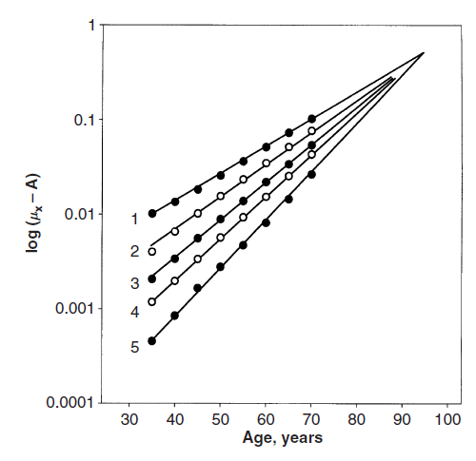
Compensation Law of mortality or Late-Life mortality convergence
Comparing the mortality dynamics in different populations of the same species indicates (Strehler and Mildvan, 1960) that:
High initial mortality is compensated with low rate of aging.
Low initial mortality is compensated with high rate of aging.
The Strehler and Mildvan correlation is expressed by:
$$\ln{{(m}_{0})}=\ln\left(M\right)−βX$$
where $X$ is the species-specific lifespan and $M$ the species-specific mortality
From Gavrilov and Gavrilova (2006)
Notes:
1. India, 2. Turkey, 3. Kenya, 4. England and Wales, 5. Norway

Slide 7
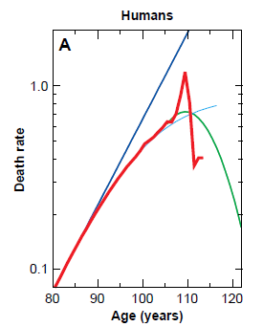
Late-life mortality deceleration
Observations at extreme old ages:
1) Deceleration 2) Level-off (plateau) 3) Decline 4) Fluctuations
From Avraam et al. (2013)
From Vaupel et al. (1998)

Slide 8
Model of heterogeneous populations
Two main questions concerning Gompertz law of mortality:
Why the mortality increase is exponential?
Why it deviates from the exponеnt at yоung and old ages?
To address the second question we have developed a model of heterogeneous human population. We assume that the human population consists of a set of subpopulations which differ genetically or by life-style conditions. The mortality dynamics of each subpopulation (indexed j) follows the Gompertz law:
$$m_{jx}=m_{j0}{e^{ }}^{β_{j}x}$$

Slide 9
Fitting heterogeneous model to actual data
Gompertz parameters for each subpopulation are different. The mortality of the entire population is modelled as a sum of weighted exponential (Gompertz) terms:
$$m_{x}=\sum_{j=1}^{n}{ρ_{jx}m_{jx}}=ρ_{1x}m_{10}e^{β_{1}x}+…+ρ_{nx}m_{n0}e^{β_{n}x}$$
Number of subpopulations and the values of parameters describing each of them are obtained by fitting the model (using statistical, i.e. BIC, criteria) to actual data.

Slide 10
Best fit is given by four-subpopulation model
Heterogeneous model is fitted to the Swedish period mortality data for the year 1900 (panel A) and the year 2000 (panel B).

Slide 11
Evolution of mortality in terms of 4-subpopulation model

Slide 12
Evolution of mortality over 20th century in Sweden
Time-evolution of mortality dynamics in the mathematical model of heterogeneous population

Slide 13
Reduction of Swedish mortality within one century
Decline of mortality due to:
changes in the structure of the population (homogenization)
changes in the Gompertzian dynamics of the subpopulations

Slide 14
Homogenisation as a consequence of natural selection
The relative fitnesses for two subpopulations are calculated for each year over the 20th century and shown in panel (A). The average ratio (0.27) of two fitnesses is used to calculate the changes in genotype frequencies due to natural (mortality) selection as shown in panel (B) over four generations (each lasting 25 calendar years).

Slide 15
Future work I: Mechanistic model for mortality dynamics
Let’s denote by $y$ the state of illness and by $x$ the state of healthiness. Therefore,
$$\frac{dy}{dt}=ay−by+cx$$
$$\frac{dx}{dt}=by−cx$$
where $a$ is the rate to “get more ill”, $b$ is the rate “to recover” and $c$ is the rate to “get ill”. In this model the mortality (value of y) is given as superposition of exponents like in the heterogeneous model

Slide 16
Future work II: Evolution of mortality in virtual population
A virtual population model:
We consider a number of entities representing living organisms.
Each organism is characterised by its age and genotype, particularly, we consider the population of diploids with subpopulations determined by genetic differences.
Every time step the organisms in the modelled population get older and, with some probability (depending on their genotype), die.
All organisms, reaching the reproductive period, mate and leave an offspring with some probability.
The offspring carries a specific genotype related to its parents’ genotypes.
Run simulations for a number of successive generations and analyse the evolution of mortality dynamics in the population.

Slide 17
People contributed to this research
Dr Demetris Avraam (past PhD student)
Dr Joao Pedro Magalhaes, Institute of Ageing and Chronic Disease, Liverpool University
Dr Severine Gaille, the University of Lausanne (Switzerland)
Dr Olga Vasieva (Ingenet, Liverpool)
Mr Dyfan Jones (project student)
Was never funded…

