Slide 1
Preheating in Gauged M-flation around the Supersymmetric Vacuum and its Gravitational Wave Signatures
Liverpool half a day meeting
October 23rd, 2013
Amjad Ashoorioon (Lancaster University)
In collaboration with
Brandon Fung (Waterloo)
Robert B. Mann (Waterloo)
Marius Oltean (McGill)
Shahin Sheikh-Jabbari (IPM)
Based on a work in progress and
A.A., H. Firouzjahi, M.M. Sheikh-Jabbari JCAP 0906:018,2009, arXiv:0903.1481 [hep-th],
A.A., H. Firouzjahi, M.M. Sheikh-Jabbari JCAP 1005 (2010) 002, arXiv:0911.4284 [hep-th]
A.A., M.M. Sheikh-Jabbari, JCAP 1106 (2011) 014, arXiv:1101.0048 [hep-th]
A.A., U.Danielsson, M. M. Sheikh-Jabbari, Phys.Lett. B713 (2012) 353, arXiv:1112.2272 [hep-th]

Slide 2
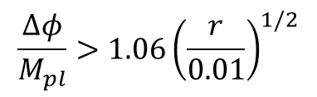
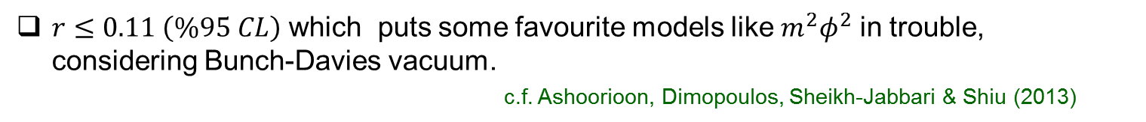
Introduction
Planck data strongly supports the idea of inflation
$r≤0.11 \left(\%95 CL\right)$ which puts some favourite models like $m^{2}φ^{2}$ in trouble, considering Bunch-Davies vacuum.
c.f. Ashoorioon, Dimopoulos, Sheikh-Jabbari & Shiu (2013)
Still any detection of $r≥0.01$ poses theoretical model-building challenges:
To embed such a model in supergravity, one has to insure the flatness of the theory on scales Lyth (1997)
$$\frac{Δφ}{M_{pl}}>1.06{\left(\frac{r}{0.01}\right)}^{1/2}$$
c.f. Choudhury & Mazumdar (2013)
In supergravity and stringy, one usually finds the size of the region in which inflation can happen to be much smaller than
McAllister & Baumann (2007)
I focus on M-flation that uses Matrices as inflaton.
Embedded preheating in some regions high frequency gravitational waves.

Slide 3

Gauged M-flation
$$R4×CY3$$
PP-wave background
parameterize 3 out
10-d IIB supergravity background
6 dim
to the D3-branes and
denotes 3 spatial dim along
and five transverse to the D3-branes.
Myers (1999)

Slide 4
Matrix Inflation from String Theory
With
the above background with constant dilaton is solution to the SUGRA
Upon the field redefinition
From the brane-theory perspective, it is necessary to choose
and
such that
We have N D3-branes that are blown up into a single giant D5-brane under the influence of RR 6-form. The inflaton corresponds to the radius of this two sphere.

Slide 5

Truncation to the SU(2) Sector:
are N X N matrices and therefore we have
scalars. It makes the analysis very
difficult
However from the specific form of the potential and since we have three
, it is possible
to show that one can consistently restrict the classical dynamics to a sector with single
scalar field:
are N dim. irreducible representation of the SU(2) algebra:
Plugging these to the action, we have:
Defining
to make the kinetic term canonical, the potential takes the form

Slide 6
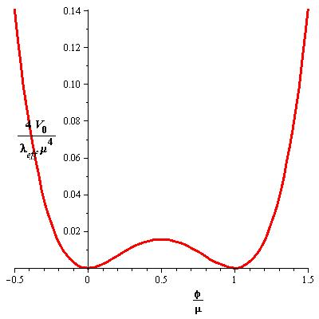
Analysis of the Gauged M-flation around the Single-Block Vacuum
Hill-top or Symmetry-Breaking
inflation, Linde (1992)
Lyth & Boubekeur (2005)
In the stringy picture, we have N D3-branes that are blown up into a giant D5-brane under the influence of RR 6-form.
(a)
(a)
(c)
(b)
(b)
(c)

Slide 7
Mass Spectrum of χ Spectators
(a)
-modes
Degeneracy of each
-mode is
(b)
-modes
Degeneracy of each
-mode is
(c)
vector modes
Degeneracy of each
-mode is

Slide 8
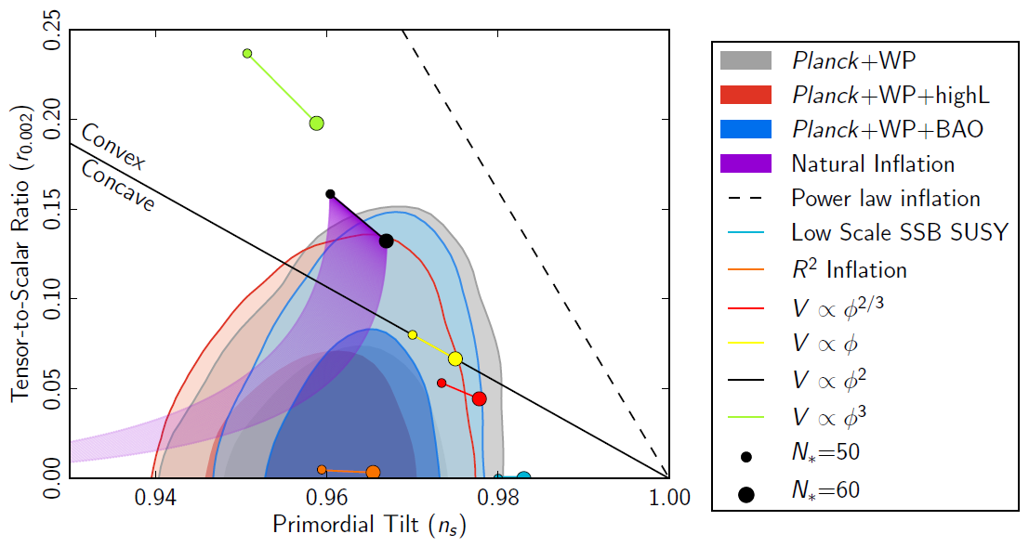



C) Power Spectra in Symmetry-Breaking Inflation
$${m_{}^{2}}_{χ}$$
$$H^{2}$$
$$n_{T}≃−0.006$$
CMBPOL or QUIET
should be able to verify
this scenario.
Gauged M-flation

Slide 9



Particle Creation and Preheating Scenario around SUSY Vacuum
The backreaction of the spectator modes on the inflaton dynamics can become
large when
This could be the bonus of our model, as spectator modes help to drain the energy
of the inflaton, since their masses change very fast.
One can show that if inflation ends in the susy-breaking vacuum, this process is
not effective to produce spectator particles through parametric resonance:
rest masses
are large around
susy-breaking
vacuum.
For$α$ and $β$ modes:
For the gauge mode
for example for α and β modes:
$$φ≡φ−μ$$
$$∀ω,$$
No parametric resonance around
the susy-breaking vacuum

Slide 10
Particle Creation and Preheating Scenario around SUSY Vacuum
The situation is quite different around the SUSY vacuum
For large values of ω for α and β modes and for all values of $l$ for the gauge
modes
parametric resonance happens.

Slide 11
GW production from Preheating
Parametric resonance could be a source of gravitational waves.
Exponential particle production for some momenta large inhomogeneities
where
This is in addition to the stochastic background of GW produced during inflation
Such GW is a probe of the inflaton potential and its couplings at the end of inflation.
Universe is transparent to GW useful source of information from early universe.

Slide 12
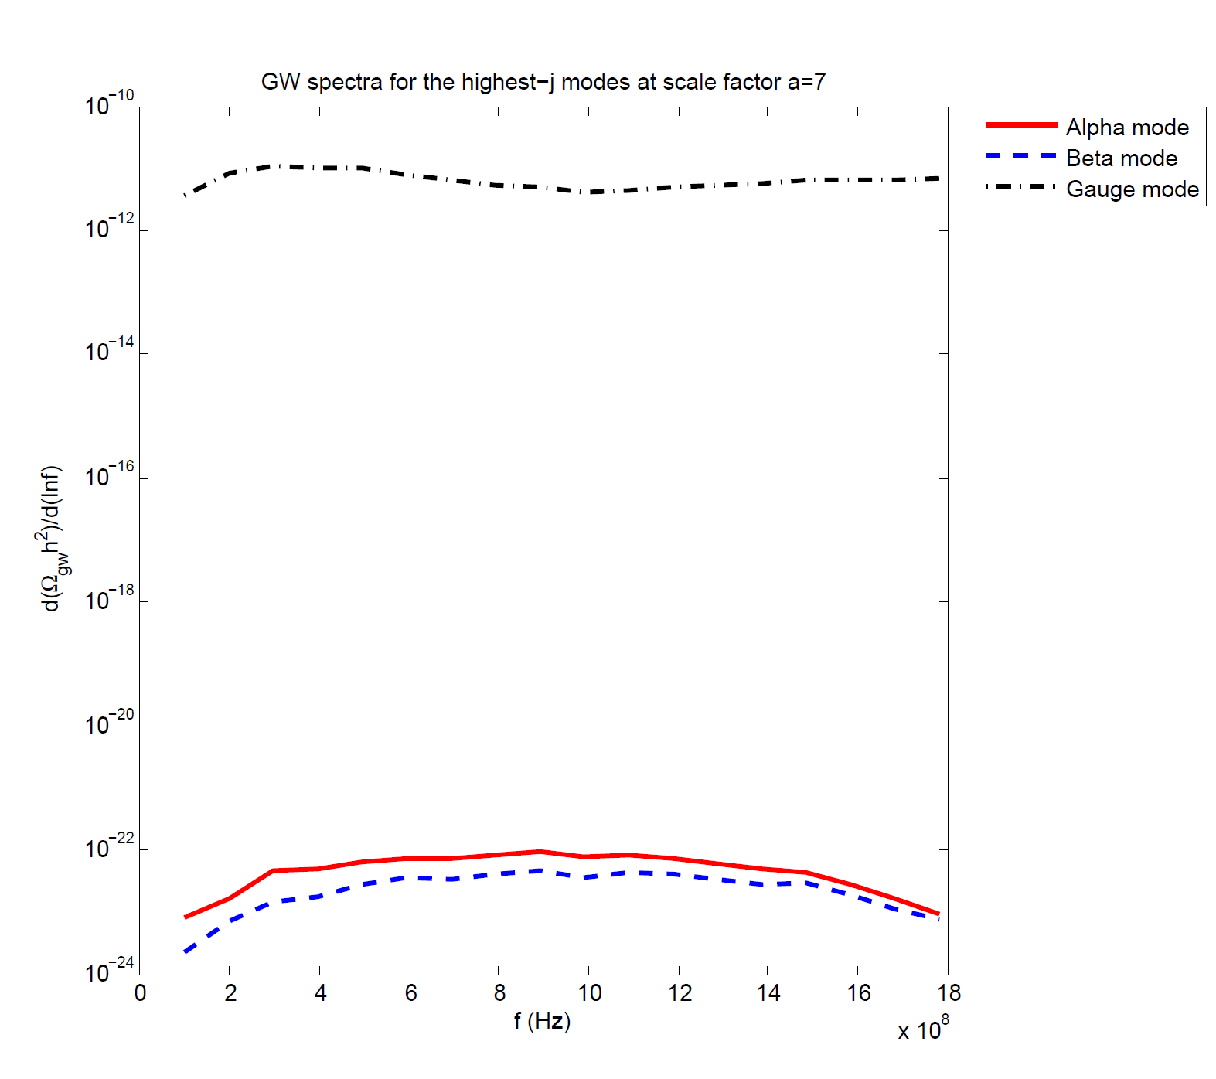
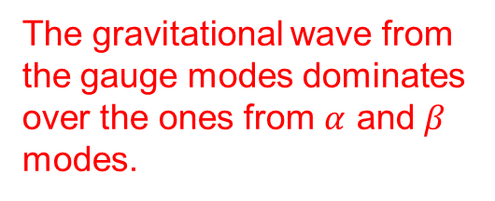
GW production from Preheating: Single Mode
We used HLattice (developed by Zhiqi Huang (2007)) to compute the GW
spectrum produced by individual highest j modes as the preheat field
The gravitational wave from
the gauge modes dominates
over the ones from $α$ and $β$
modes.

Slide 13






$$n_{k}$$
Largest j Gauge modes
$$ℓ=0$$
$$t′$$
$$n_{k}$$
Largest j beta mode
$$ℓ=0$$
$$t′$$

Slide 14
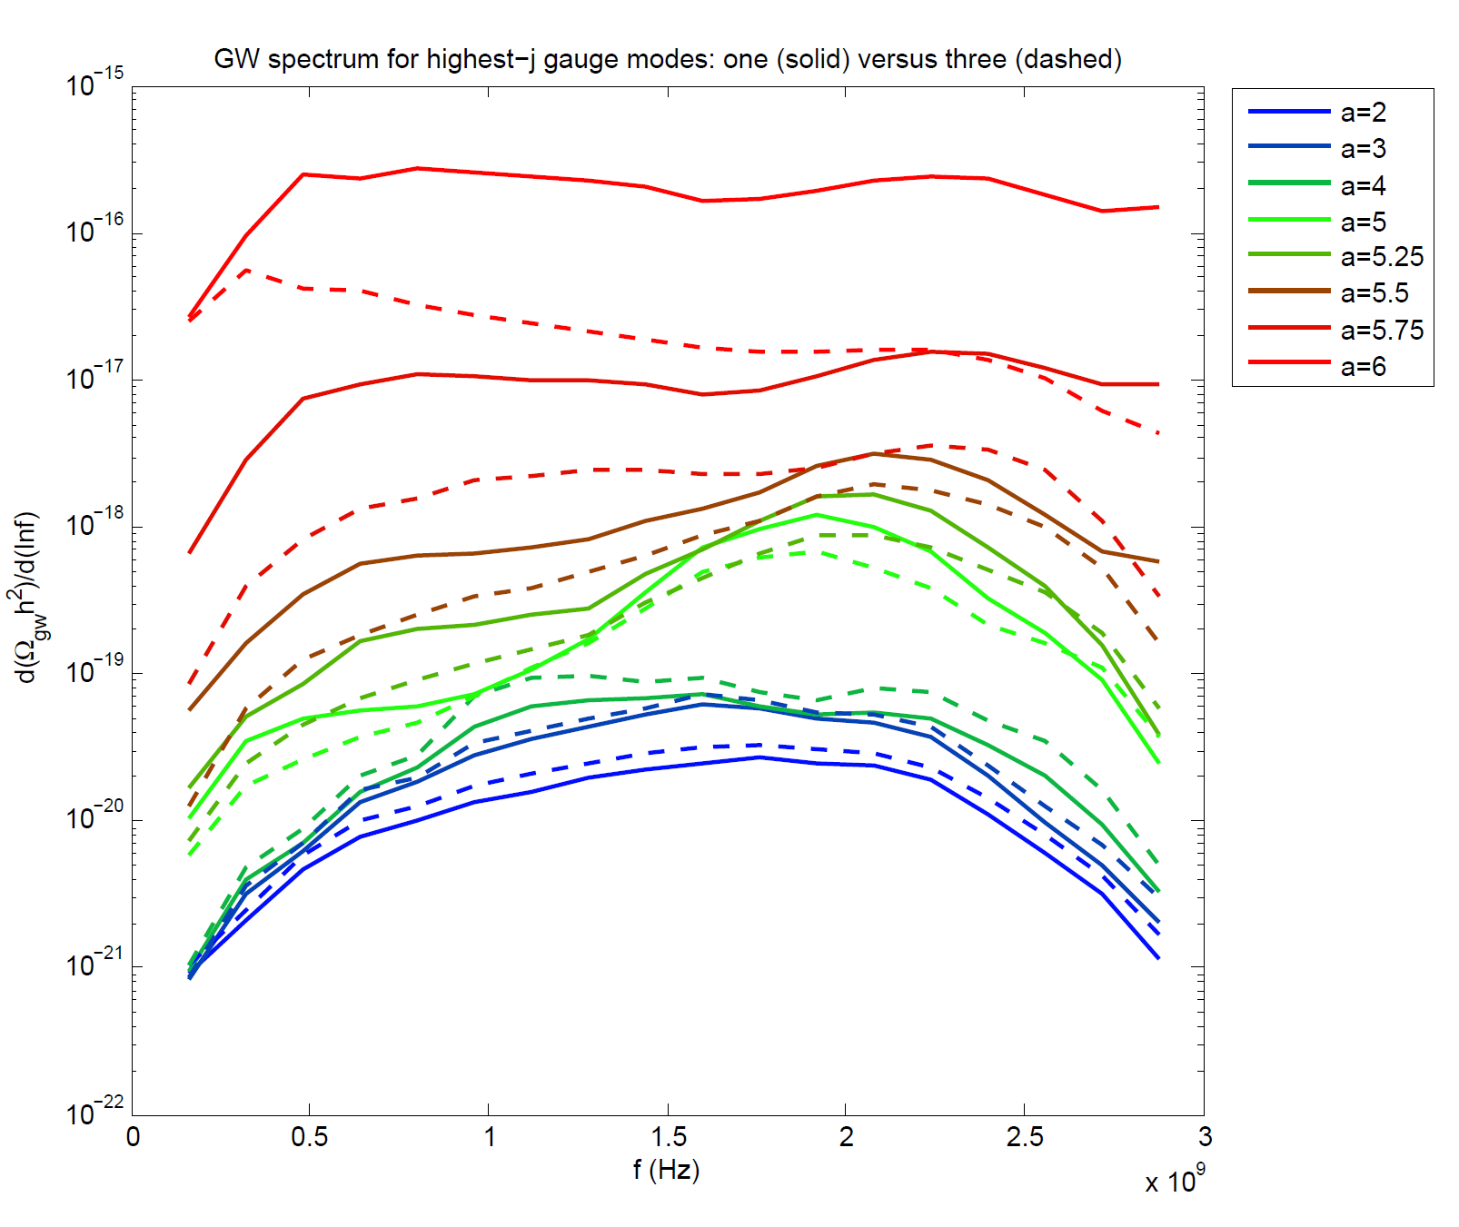
GW production from Preheating: Three largest j Gauge Mode
The signal may be seen
in HFGW detectors that
probe the GHz band
Birmingham HFGW detector
or
INFN Genoa HFGW resonant antenna

Slide 15
Conclusions
M-flation solves the fine-tunings associated with chaotic inflation couplings and produce super-Planckian effective field excursions during inflation.
M-flation which is qualitatively new third venue within string theory inflationary
model-building using the internal matrix degrees of freedom.
Matrix nature of the fields suggests isocurvature productions at the CMB scales.
Hierarchical mass structure of the isocurvature modes, one can avoid the
“beyond-the-cutoff” problem.
A.A., M.M. Sheikh-Jabbari, JCAP 1106 (2011) 014, arXiv:1101.0048 [hep-th]

Slide 16

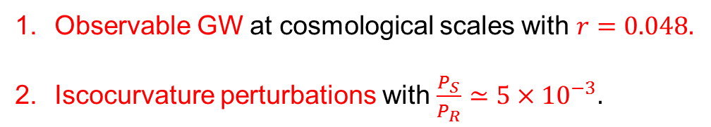
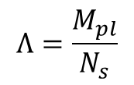
Conclusions
Interactions of the graviton with the scalar field $\frac{Λ^{2}}{M_{p}^{2}} R η−$problem if
In many-field models like M-flation, the problem can be avoided
$$Λ=M_{pl}$$
$$Λ=\frac{M_{pl}}{N_{s}}$$
Ashoorioon, Danielsson, Sheikh-Jabbari,
Phys.Lett. B713 (2012)
M-flation has a natural built-in mechanism of preheating around the SUSY vacuum.
The couplings of the preheat fields are related to self couplings of inflaton, thus known.
The parametric resonance produces large GHz frequency GW which could be seen
by ultra-high frequency gravitational probes like Birmingham or the one at INFN,
Genoa.
Other signatures in this inflationary region:
Observable GW at cosmological scales with $r=0.048.$
Iscocurvature perturbations with $\frac{P_{S}}{P_{R}}≃5×{10}^{−3}.$

Slide 17
Thank you

