Slide 1
Beyond Dirac: this Liverpool experimentalist’s Perspective
“Get to know each Other”
Liverpool
October 23rd 2013
John Dainton
Univ Liverpool and the Cockcroft Institute, UK
Overview
The Energy Frontier
The Rarity Frontier
Accelerator Science
Outlook

Slide 2
1. Overview

Slide 3
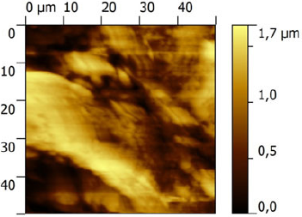
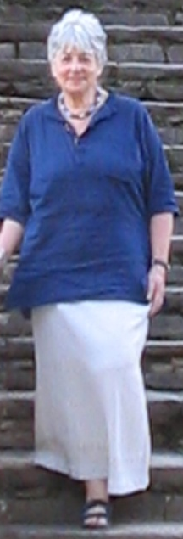
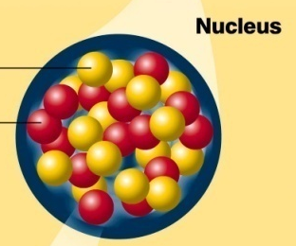
The Standard Model
← towards unification
… modestly
Planck
graviton?
gravity
γ
ALICE ERLP THz+SNOM CI Nov 2011
electro
dynamics
γ Z⁰W
electroweak
grand unification ?
unification
W
weak β
unification ?
W Z q physics
StandardModel
new physics ?
pQCD
Fermi
←LHC
gluon
chromo
dynamics
H
quantum coherence?
(Fröhlich 1970)
strong
Z⁰
10²⁴ 10¹⁹ 10¹⁴ 10⁹ 10⁴ GeV 100 MeV 1 KeV mom^{m} xfer
10⁻⁴⁰
10⁻³⁵
10⁻³⁰
10⁻²⁵
10⁻²⁰
10⁻¹⁵
10⁻¹⁰
10⁻⁵
1
m

Slide 4
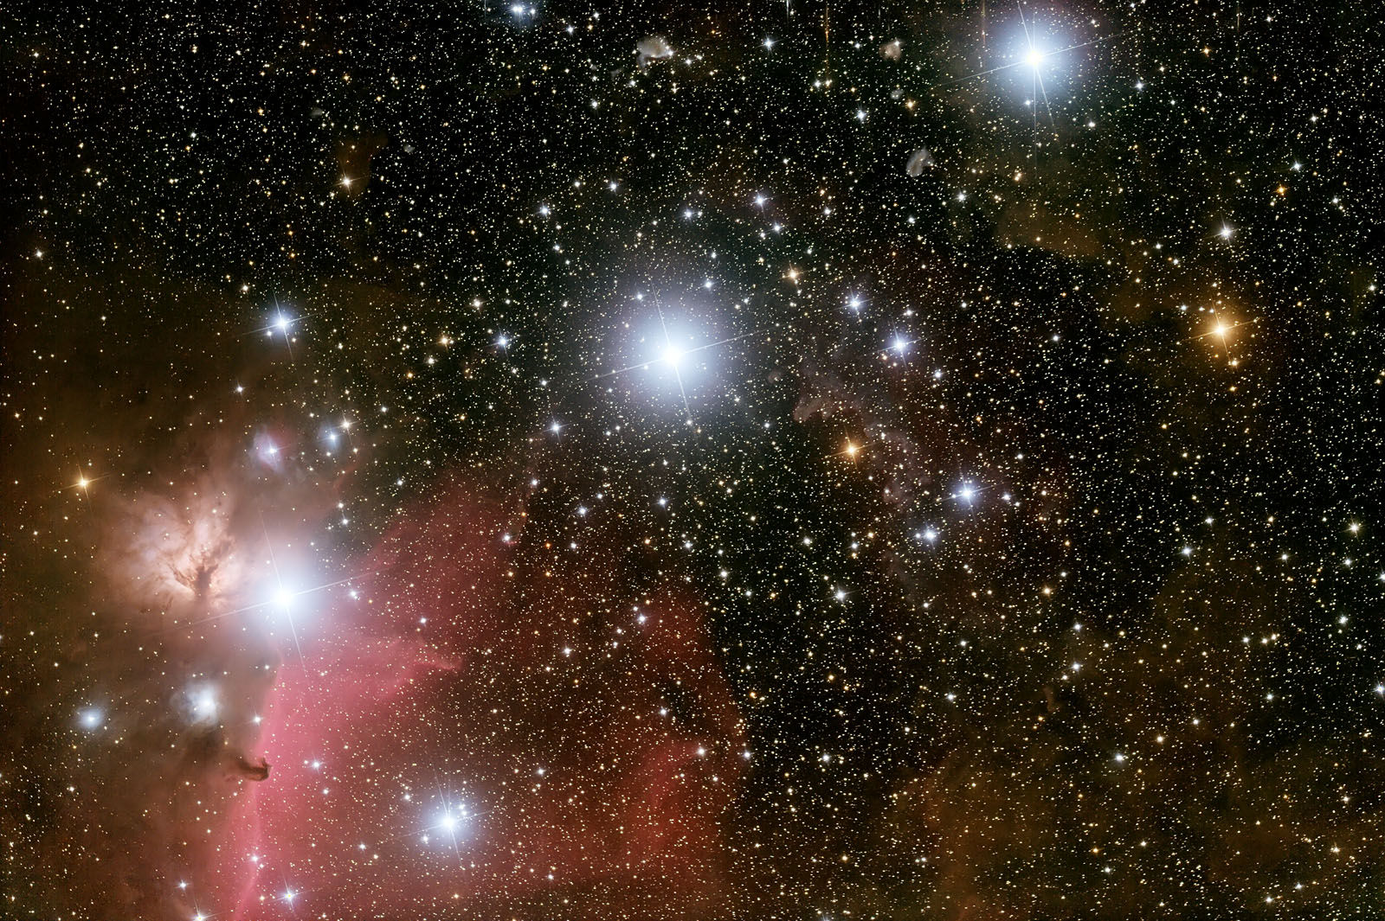
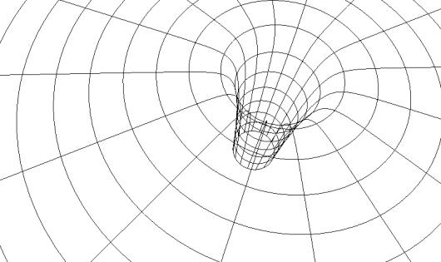
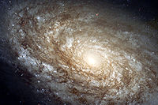
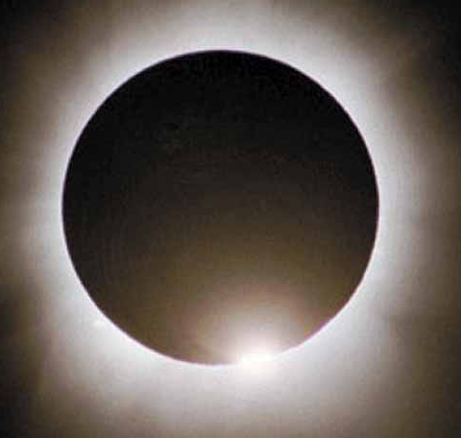

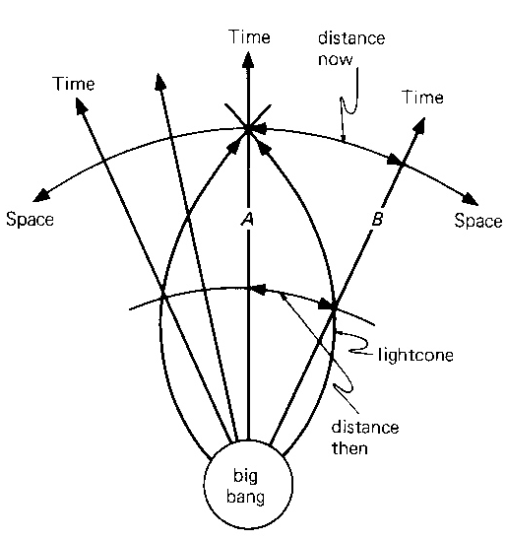
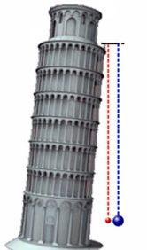

The Universe
gravity
β weak
electrodynamics
beyond horizon only gravity ?
chromodynamics
global physics
quantum coherence?
stellar
physics
galactic
physics
cosmos
3×10⁻²¹
3×10⁻¹⁶
3×10⁻¹¹
3×10⁻⁶
0.3
3×10⁴
3×10⁹
3×10¹⁴
light years
10⁻⁵
1
10⁵
10¹⁰
10¹⁵
10²⁰
10²⁵
10³⁰
10³⁵
m

Slide 5
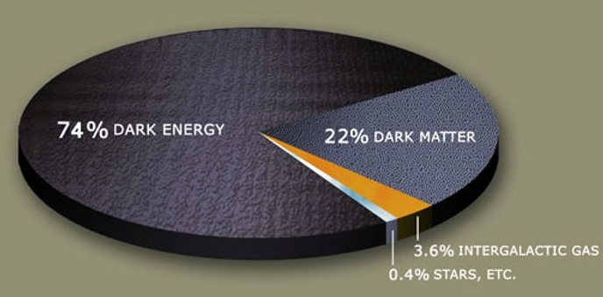
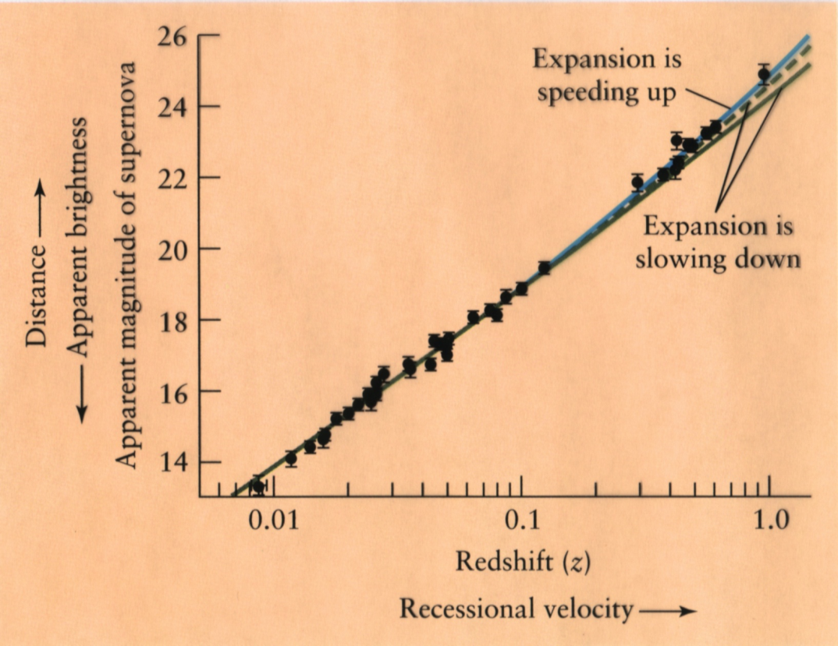

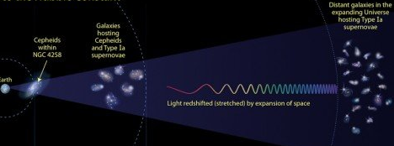
The Universe
gravity
β weak
electrodynamics
beyond horizon only gravity ?
chromodynamics
“Deep into that darkness peering, long I stood there, wondering, fearing, doubting, dreaming dreams no mortal ever dared to dream before.”
Edgar Allan Poe
3×10⁻²¹
3×10⁻¹⁶
3×10⁻¹¹
3×10⁻⁶
0.3
3×10⁴
3×10⁹
3×10¹⁴
light years
10⁻⁵
1
10⁵
10¹⁰
10¹⁵
10²⁰
10²⁵
10³⁰
10³⁵
m

Slide 6
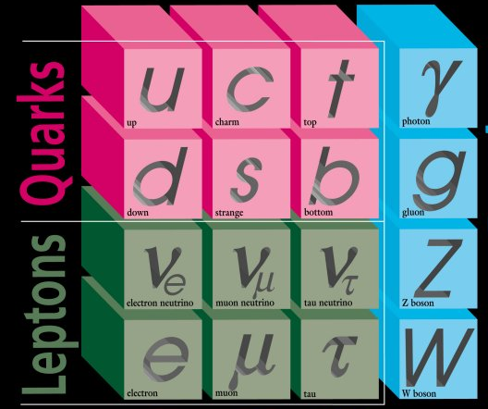
Matter: the Standard Model
γ Z W
+ H
Higgs
γ Z W
+ H
g
• ubiquitous scalar gauge field + SSB → mass
• sub-fm = u +d +e + relativity/QCD → us !
+
confine

Slide 7
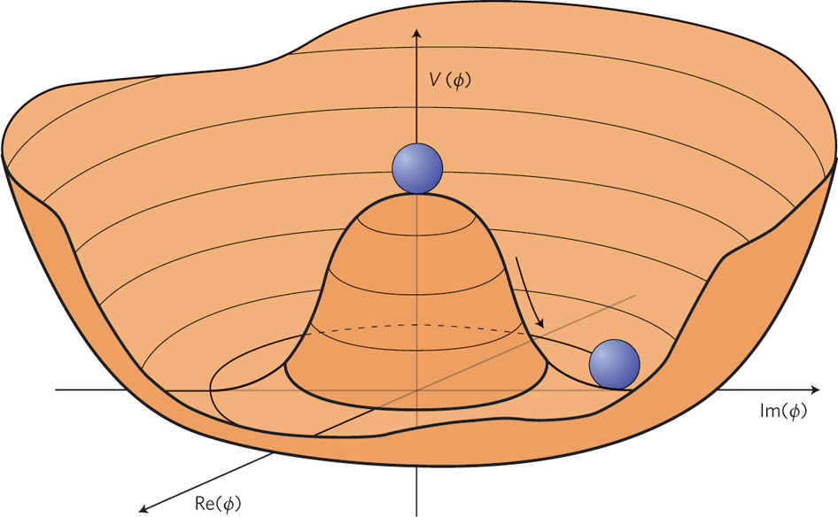
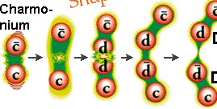
The Standard Model
• “gauge theory” SU(2)_{L} ⊗ U(1) + SSB
→ H + SU(2)_{L} W± Z⁰ + lepton+quark mass
+ mass-less γ
→ P C CP T
CPT
→ vacuum
cosmos
γ Z W
+ H
SSB
?
γ Z W
+ H
• SU(3)_{L=R} colour → asymptotic freedom
+ confinement
→ mass
→ matter
→ chirality
g
quark
→
jet
+
confine

Slide 8
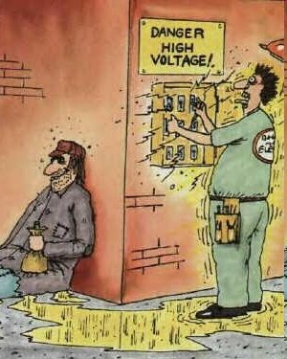
The Gauge Principle
●physics invariant under local gauge transformation
- physics cannot
depend on absolute
value of any potential
- physics depends on
potential difference
→ on fields
gauge principle
≡ local phase invariance
interaction structure
γ Z W
gluons 8_{C}

Slide 9
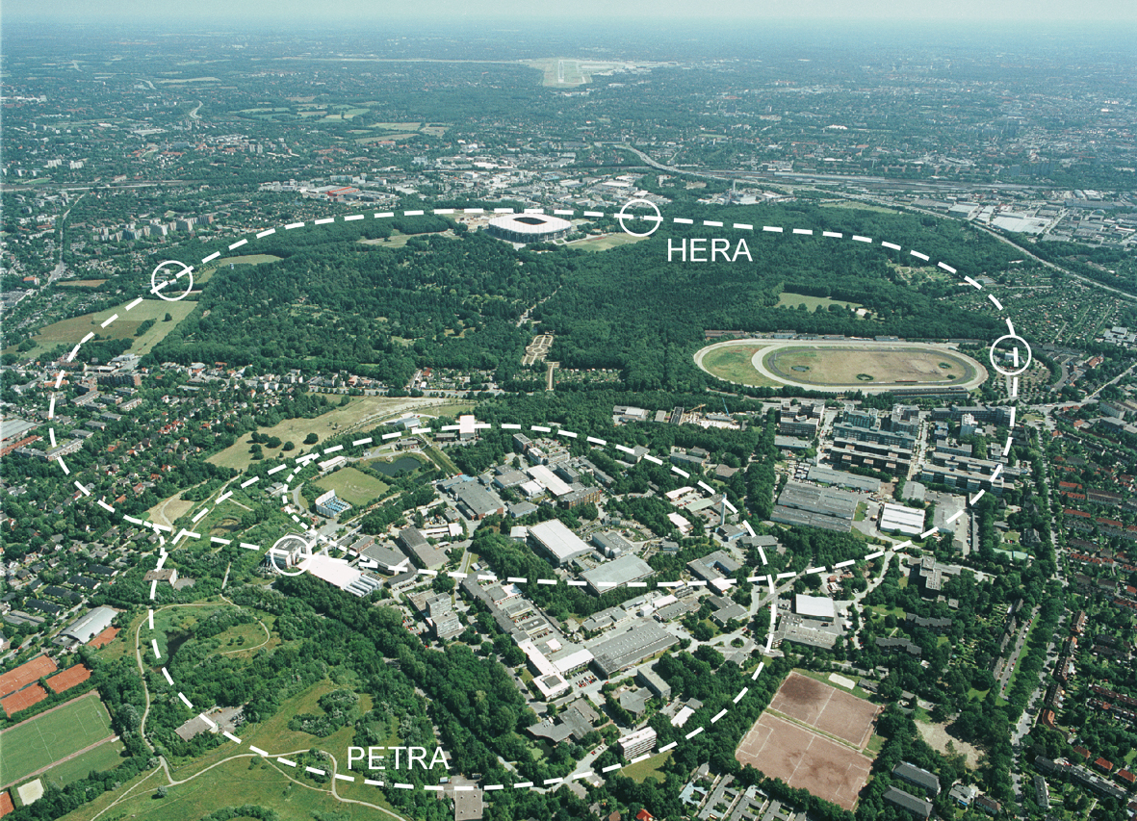

A Fermi Scale precision Collider HERA @ DESY
• challenge: different particle species ep in collision
27.6 GeV electrons + 920 GeV protons
uud +…
lepton
Hermes
HERA
DESY
Hamburg
electrons
H1
ZEUS
protons
1992-2007
RIP

Slide 10
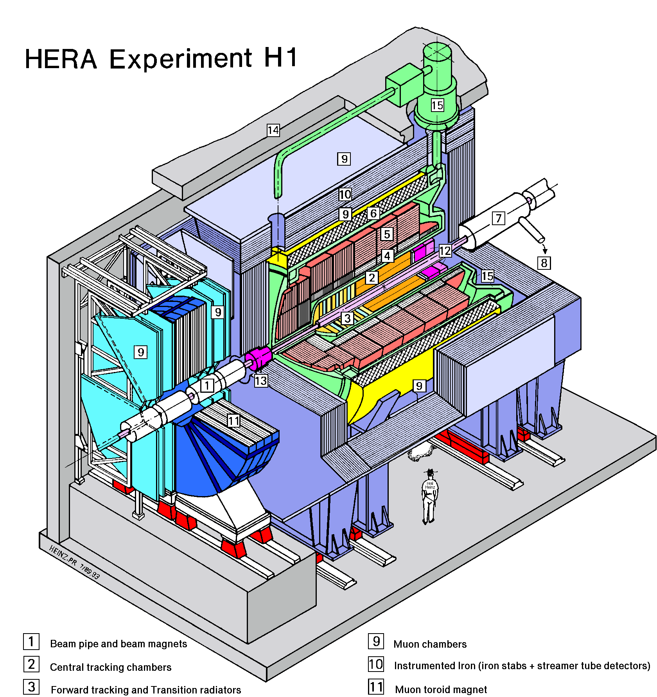
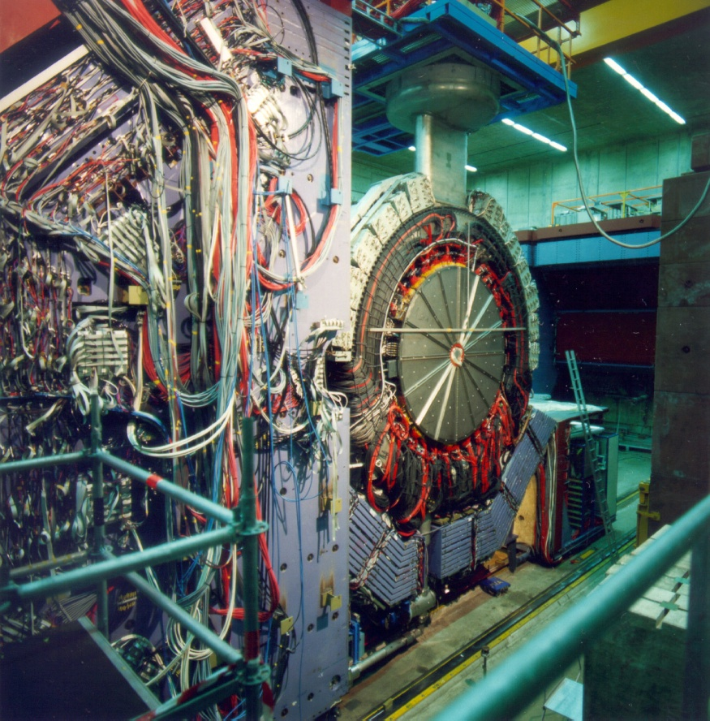

Detect collision fragments
protons
electrons
electrons
• large complex detectors
in which particles leave their mark

Slide 11
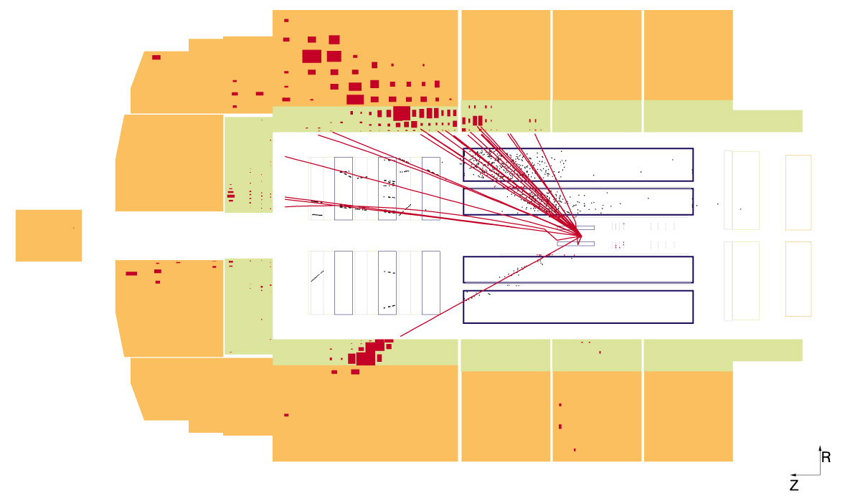
Electron and proton collide
← → “stored” high energy beams
electron
proton
side-view

Slide 12
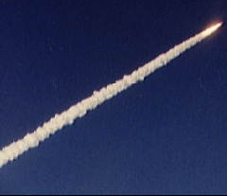
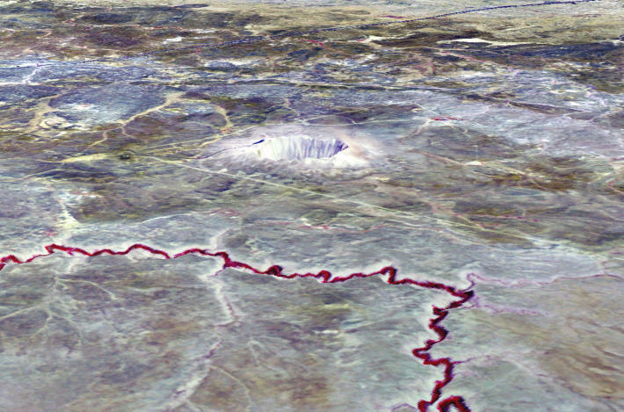
Detect Particles in Matter
Detect (and Destroy)
Particles in Matter
Detect (and do not Disturb)
Particles in Matter
Arizona
topological directions and kinematic balance

Slide 13
Electron recoils, proton shatters
particles from struck
part of proton = “parton”
proton
remnant
in and
around
continuing proton beam
electron
proton
electron
electron
“back-scattered”

Slide 14
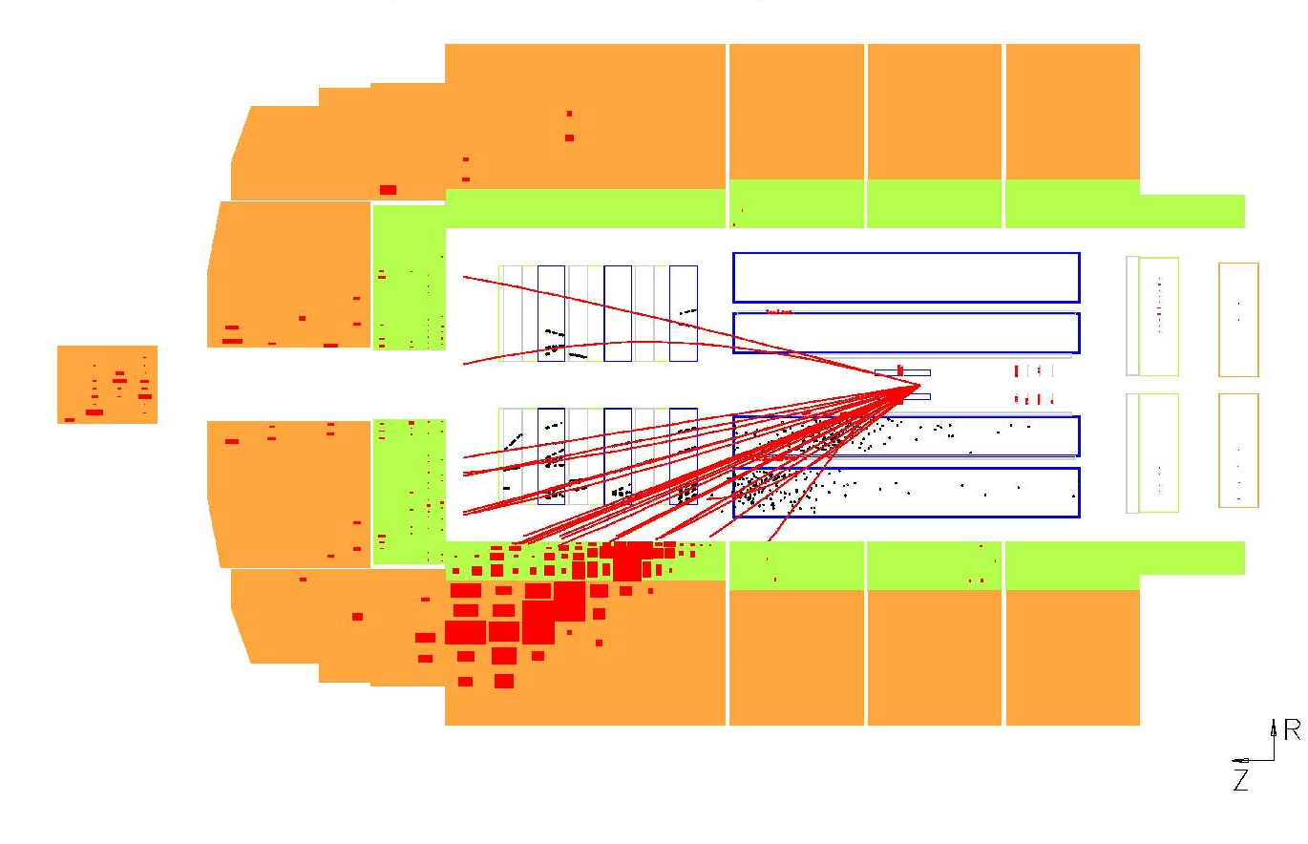
Electron and proton collide
electron?
← → “stored” high energy beams
electron
proton
particles from
struck part of proton = “parton”
topological directions and kinematic imbalance

Slide 15
2. The Energy Frontier

Slide 16
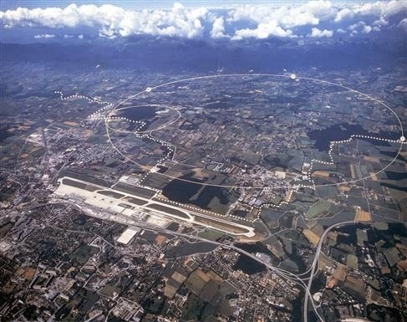
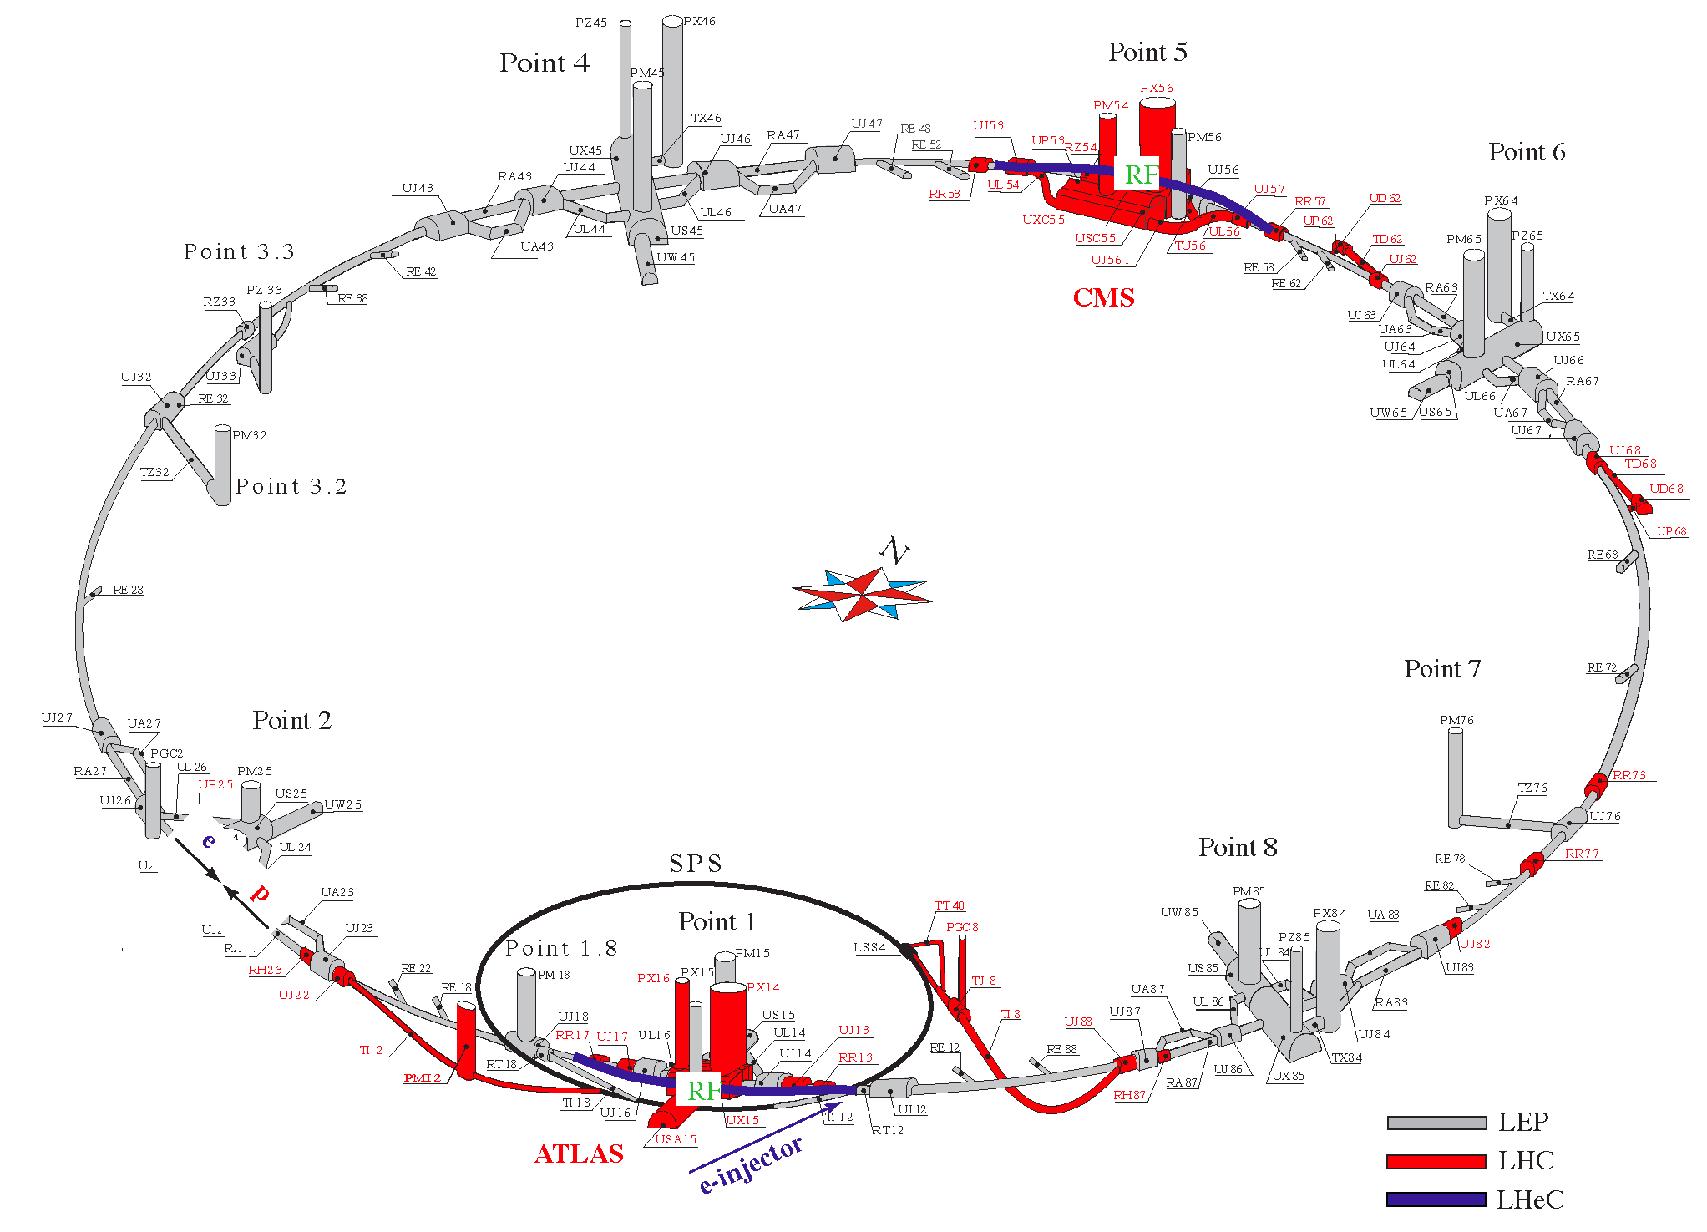


The Energy Frontier
• 20th century technology … for the 21st century
LHC
circumference 26 km

Slide 17
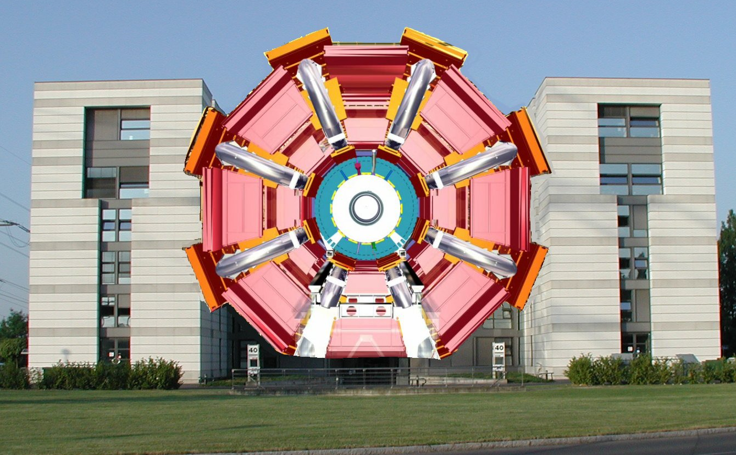
The Energy Frontier
• putting energy and quarks together
• LHC 7+7 TeV pp CERN, Geneva +ATLAS
ATLAS
p

Slide 18
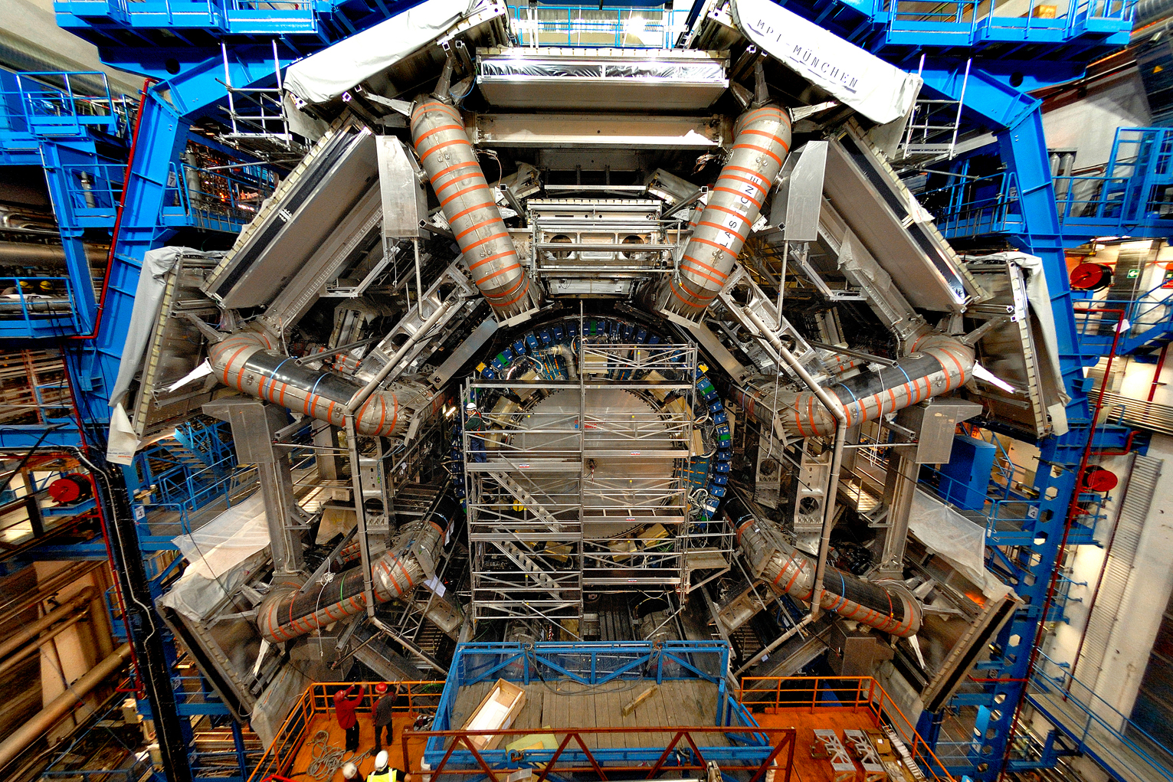

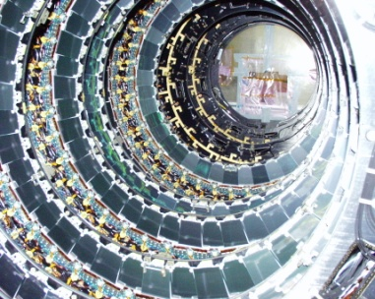
Enormous detector (42m x 22 m x 22m)

Slide 19
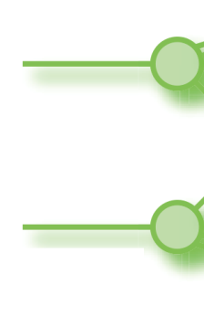
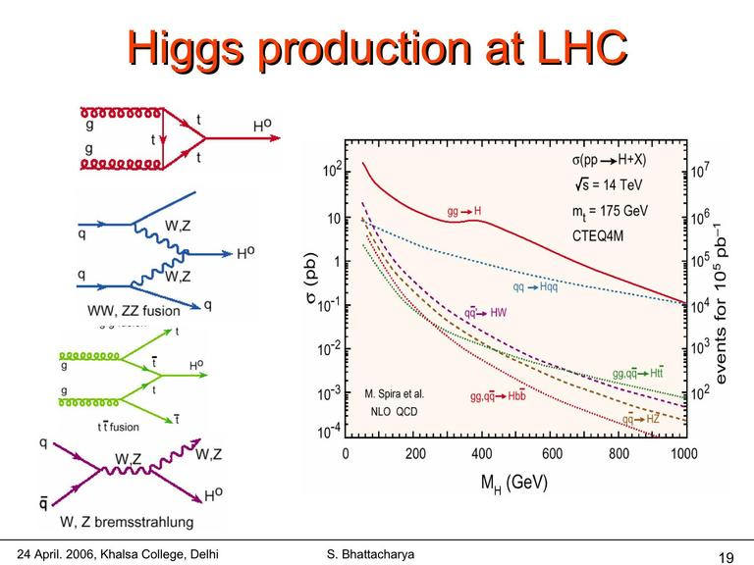
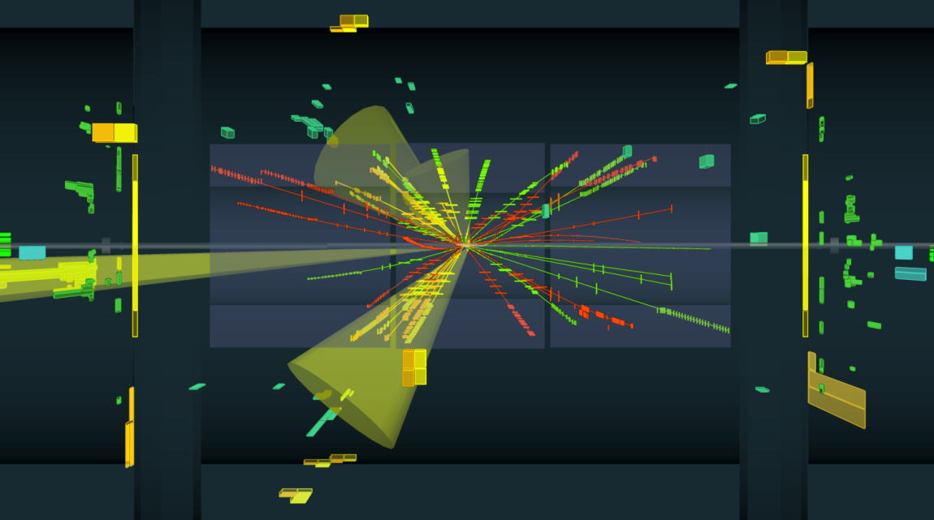
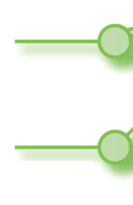

ATLAS @ LHC: Higgs ?
• from many of
these
which of these?
P
p
P
p
P
p
proton →
← proton
P
p

Slide 20
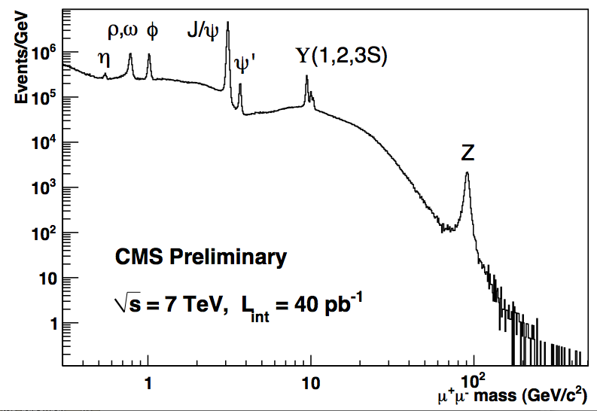
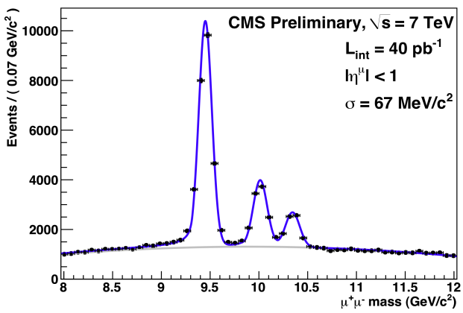
The LHC !
• precision: very first data 2009
1960
1974
1977
1982

Slide 21
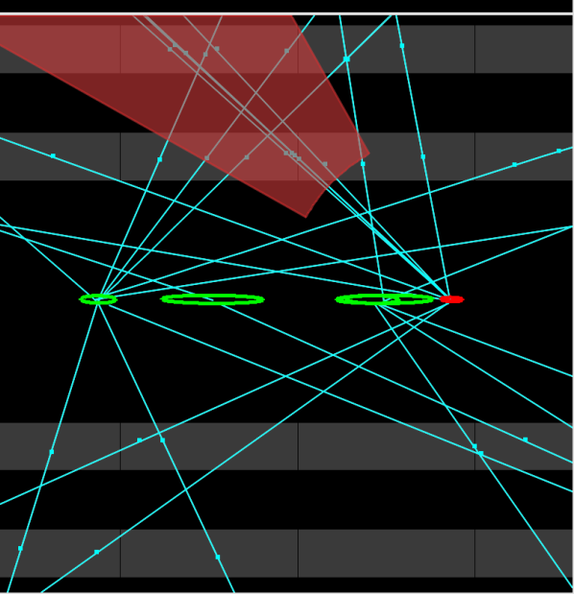


ATLAS Higgs→γγ

Slide 22
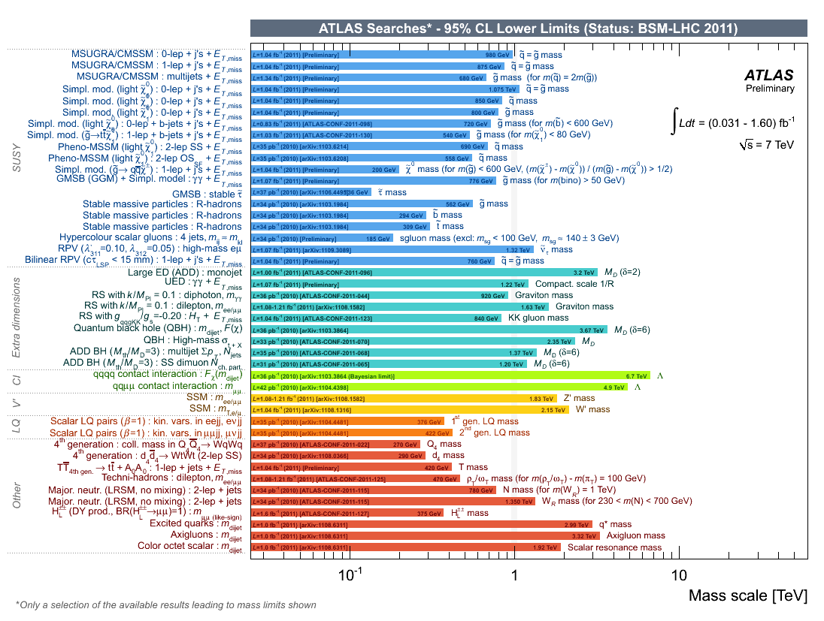
The Energy Frontier: Terascale ?
• exclusion – the future is still ahead of us !
TeV

Slide 23
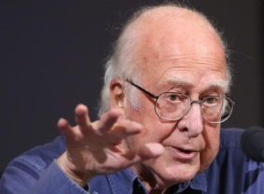
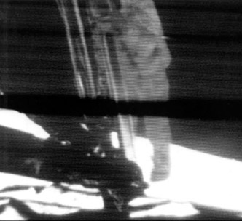
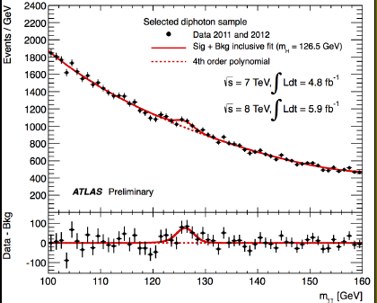
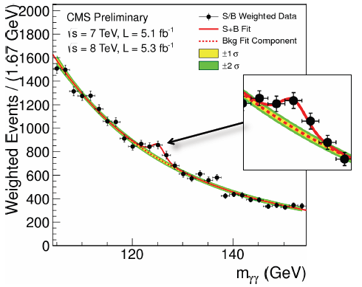
ATLAS @ LHC: Higgs ?
CMS @ LHC: Higgs ?
• a “huge step for mankind”

Slide 24
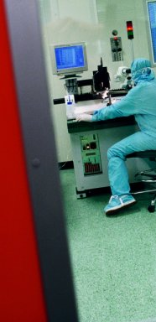
Liverpool Semi-conductor Centre (LSDC)
• outstanding global centre for R&D
- leaders RD50 (~300 globally)
• defining Si for LHC exp^{ts}
- present + future (upgrades)

Slide 25
3. The Rarity Frontier

Slide 26
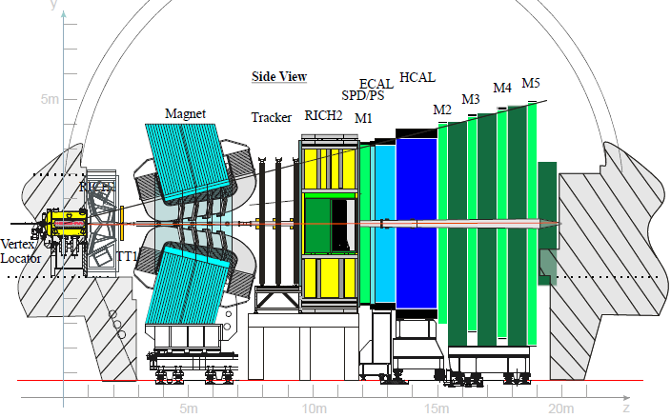
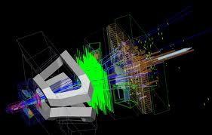
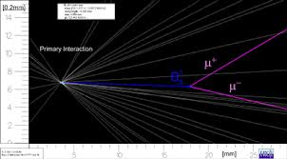
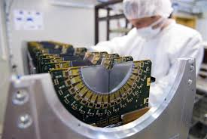
LHCb: Flavour – c b t
• pp → pp + “forward high multiplicity”
+ J ϒ c B t
- tracking in the highest ever multiplicity
- Liverpool VeLo
p
p

Slide 27
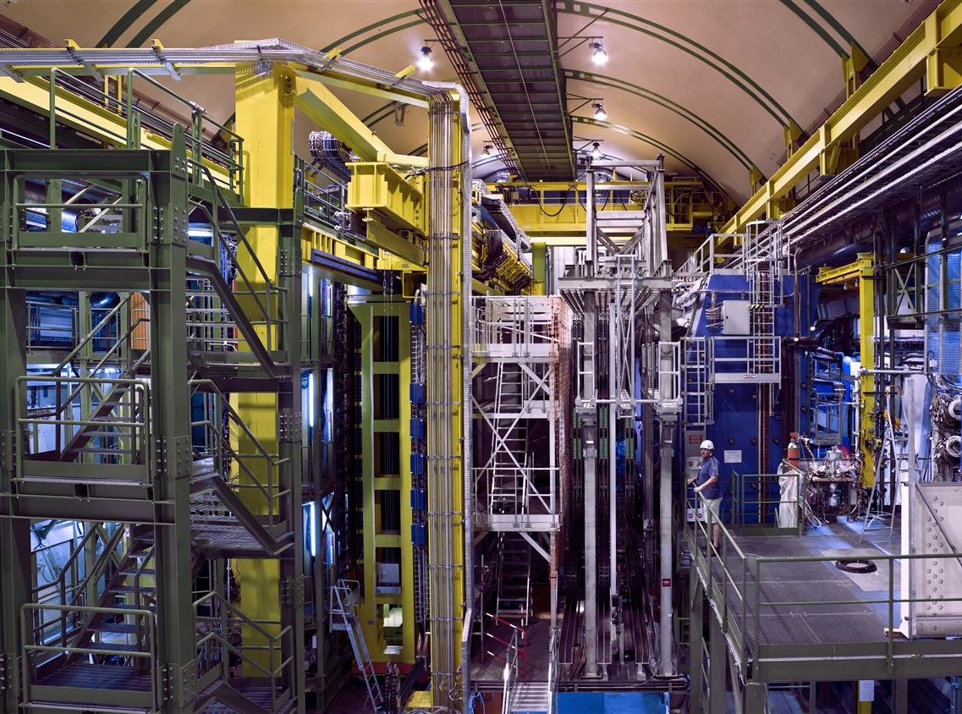
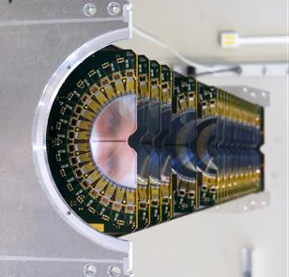
LHCb
VErtex LOcator

Slide 28
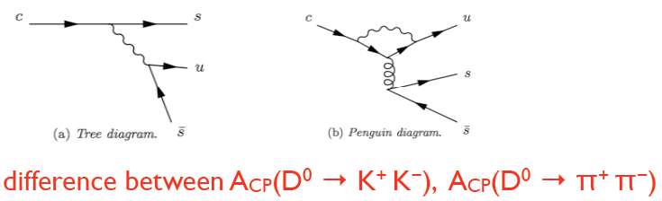
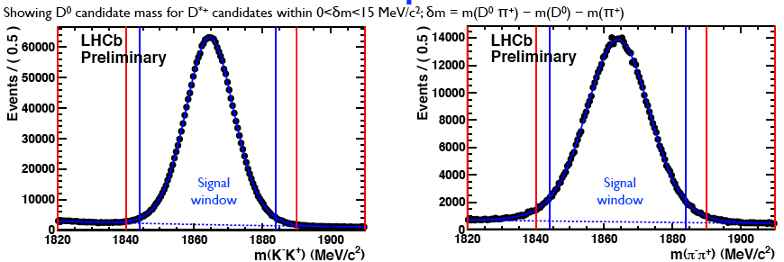
LHCb: Flavour
• CP in D⁰ decay: precision from LHCb
- metric
• CP in D⁰ decay: precision from LHCb
_
D⁰-D⁰
(
).(
)*
A_{CP}=
_
→
2Re
D⁰+D⁰
_
- difference between interferences D and D
D⁰→K⁺K⁻
D⁰→π⁺π⁻

Slide 29
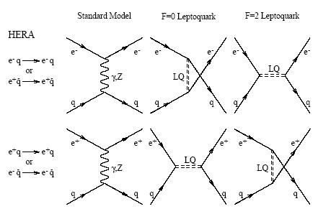

Measurement @ the Fermi-scale
Measurement > the Fermi-scale
● accuracy in what we can know
~10³² cm⁻²s⁻¹
SM e±q
NC
CC
Beyond SM e±q NC CC
t-channel
u-channel
s-channel
>M_{ZW}
10⁻⁸
← ~1000 ev/100 fb⁻¹
SM > 5×10⁵ GeV²
2000 ev/100 fb⁻¹
10⁻¹⁰
10³
10⁴
10⁵
10⁶
“contact”
> Q² and >s_{ep}
Q² (GeV²)
→ new amplitudes from new physics
Q² (GeV²)

Slide 30

Measurement @ the Terascale
_
●new amplitudes from new physics
- < kinematic threshold (large M_{new})
- short distance “contact”
M_{new}
_
α
²
decay
Г~
²
M_{new}
●universal coupling ?
Г_{new}/ Г _{EW} ~ BR ~ (M_{new}/M_{EW})⁻⁴
M_{new}~ 30 TeV
M_{EW}~ 0.1 TeV
→ BR ~ 10⁻¹⁰
_
● eg K⁺→π⁺νν CERN NA62
rare B SuperBelle
- BR sensitivity 10⁻¹¹ includingflavour

Slide 31






NA62: flavour - s
• K±-decay in flight (75 GeV)
- precision kinematic selection
- 1000 events/10⁻¹¹
- first data fall-2014
Liverpool

Slide 32

Steve Maxfield
University of Liverpool
sjm@hep.ph.liv.ac.uk

Slide 33


Slide 34


Slide 35


ν-mixing
• ν propagation in mass eigenstate e^{iEct}
- production/decay in flavour eigenstate e μ
ν_{e} ← oscillation → ν_{μ}
eg
ν mass
?

Slide 36



T2K Japan
• long base-line for ν_{μ} → ν_{e}
- measure near and far ν_{e}p →en

Slide 37

T2K Japan
• “ near” detector: EM calorimeter for ν_{μ} → ν_{e}
- Liverpool

Slide 38



SM Low Mass Scale
• SM low mass scale: the scroll
≥1 ν with m_{ν} > 0.04 GeV
Oct 2013

Slide 39

Atomic Phase Graviometry

Slide 40



Atomic Phase Graviometry
• local phase invariance in Earth’s g
← metres
few 10s x
metres →

Slide 41






CASCADE – SC cavity for HSP
• hidden sector photons
• anomalous coupling sc cavities
- sc Q~10⁹ (nc Q~10⁶)
- cryo → S/N ~ thermal
- mass 1’s – 100’s meV

Slide 42
4. Spin-out

Slide 43


Slide 44


Slide 45


Slide 46
4. Accelerator Science

Slide 47








R&D Challenge …
High Energy
Physics
• global
• universal
- MV/m
- intensity
- nm delivery
“light fantastic”
LCLS
ILC
LHC
XFEL
Cockcroft
Institute
+UK plc
ESS
ν-Factory
neutrons
DIAMOND

Slide 48


The Energy Frontier: e⁺e⁻ ?
• the energy frontier ? ILC ?
Parameter | Value
C.M. Energy | 500 GeV
Peak luminosity | 2x10³⁴ cm⁻²s⁻¹
Beam Rep. rate | 5 Hz
Pulse time duration | 1 ms
Average beam current | 9 mA (in pulse)
Av. field gradient | 31.5 MV/m
# 9-cell cavity | 14,560
# cryomodule | 1,680
# RF units | 560
- MV/m
• cost: $ ¥ € ₤ CHF and socio-enviro-economic?
• feasibility
- industrialisation and procurement ?
- quality, reliability, scale ?

Slide 49



The Energy Frontier: e⁺e⁻ ?
• the energy frontier ? CLIC ?
- MV/m
Main beam line
Drive beam line
• cost: $ ¥ € ₤ and socio-enviro-economic?
• feasibility
- industrialisation and procurement ?
- quality, reliability, scale ?

Slide 50



The Energy Frontier: e⁺e⁻ ?
• wake-field: p + plasma = 2 GeV/m ?
field
e cloud
e
p
1TeV
2 GeV/m
“several hundred GeV e in a few hundred metres”
A. Caldwell, K. Lotov, A. Pukhov, F. Simon, Nature Phys. 5, 363 (2009)

Slide 51


Advanced Test Facilities at CI/DL
  ALICE (Energy Recovery SCRF Linac-based IRFEL)
  → THz Cancer Imaging, Type III Solar Cells
  EMMA (NS-FFAG- compact electron model)
  → Ultra-fast Acceleration of Muons
  VELA (Industrial Linac Test Facility)
  → User Base: Rapiscan, e2v, Siemens
  CLARA (FEL Test facility)
  → Test “Seeded” FEL concepts
  Atom Traps and Interferometers
  → “Ultra-cold” Electron Sources
  → Laboratory experiments on
    Dark Energy and Matter
Cockcroft
Institute/
Daresbury
Laboratory

Slide 52





THz Science
• THz CSR bunch
• dedicated tissue culture laboratory
• IR/THz on living cells
• high peak intensity
very low <power>
no thermal effects
IR/THz from ALICE

Slide 53
5. Outlook

Slide 54
Beyond the Standard Model?
γ Z W
+ H
Higgs
γ Z W
+ H
g
+
confine
• Dirac fermions and gauge bosons

Slide 55






Beyond the Standard Model?
• Dirac fermions + local SU(2) _{L} + U(1)
- Lorentz invariance
- local phase invariance
mystery beyond Dirac fermions
?

